Slide 1


The PHM ExploreR An open-source suite to facilitate engagement in Population Health Management
@BNSSGAnalytics
Andras Varady
Richard Wood

Slide 2

Funding and support
We gratefully acknowledge the support to this project provided by The Health Foundation.
This has been funded under Round 4 of the Advancing Applied Analytics award.

Slide 3
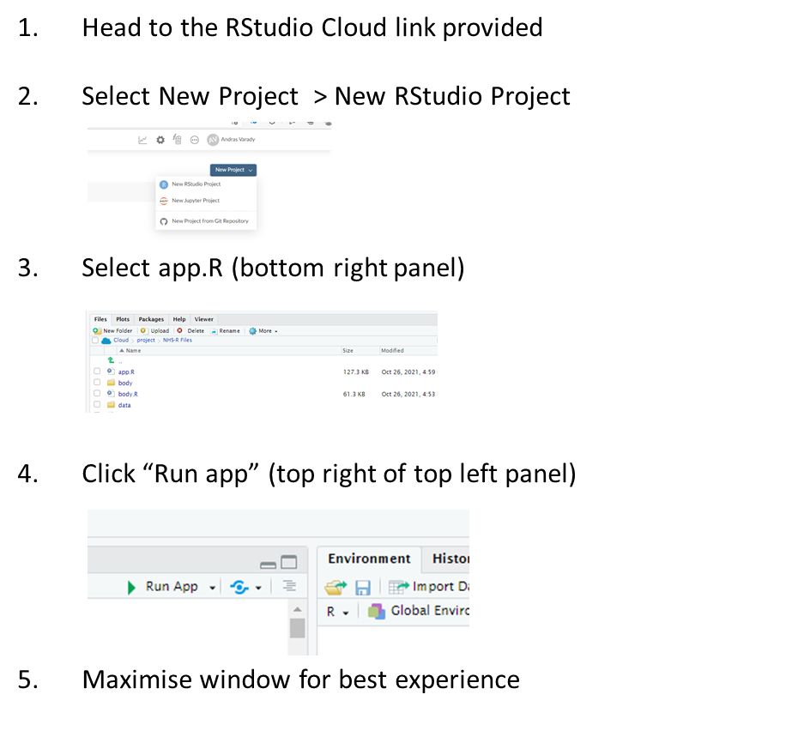
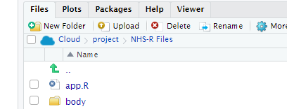
To Get Started:

Slide 4
Workshop schedule
10:00 - 10:15 Introduction to Population Health Management & the PHM ExploreR
10:15 - 11:00 Data format, demographics, segmentation
11:00 - 11:05 Break
11:05 - 11:45 Risk stratification, Theoplots
11:45 - 12:00 Questions
Notes:
There will be time to ask questions as we go
I’ll be watching the chat to key an eye in question

Slide 5
What is Population Health Management?
“PHM focuses on key outcomes for identified groups. Often these groups share more specific common characteristics, not just a disease diagnosis”
“During 2019, we will deploy PHM solutions to support ICSs to understand the areas of greatest health need and match NHS services to meet them. Over the coming years these solutions will become increasingly sophisticated in identifying those groups of people who are at risk of adverse health outcomes”
Deloitte
“PHM is the concept of gathering data and insights about population health and wellbeing across multiple care and service settings, with a view to identifying the main health care needs of the community and adapting services accordingly”
NHS Long Term Plan
Nuffield Trust
Notes:
Astonishingly, only around 20% of a person’s health outcomes are attributable to their ability to access good quality health care. The other 80% are made up of ‘social determinants of health’. These include health related behaviours, socio-economic factors, and environmental factors, and they all play a part in the chances of someone living a long, happy and healthy life.
PHM aims to deliver the NHS Long Term Plan’s goal to move from delivering care that mainly responds when someone becomes unwell to a system of targeted early intervention and prevention

Slide 6
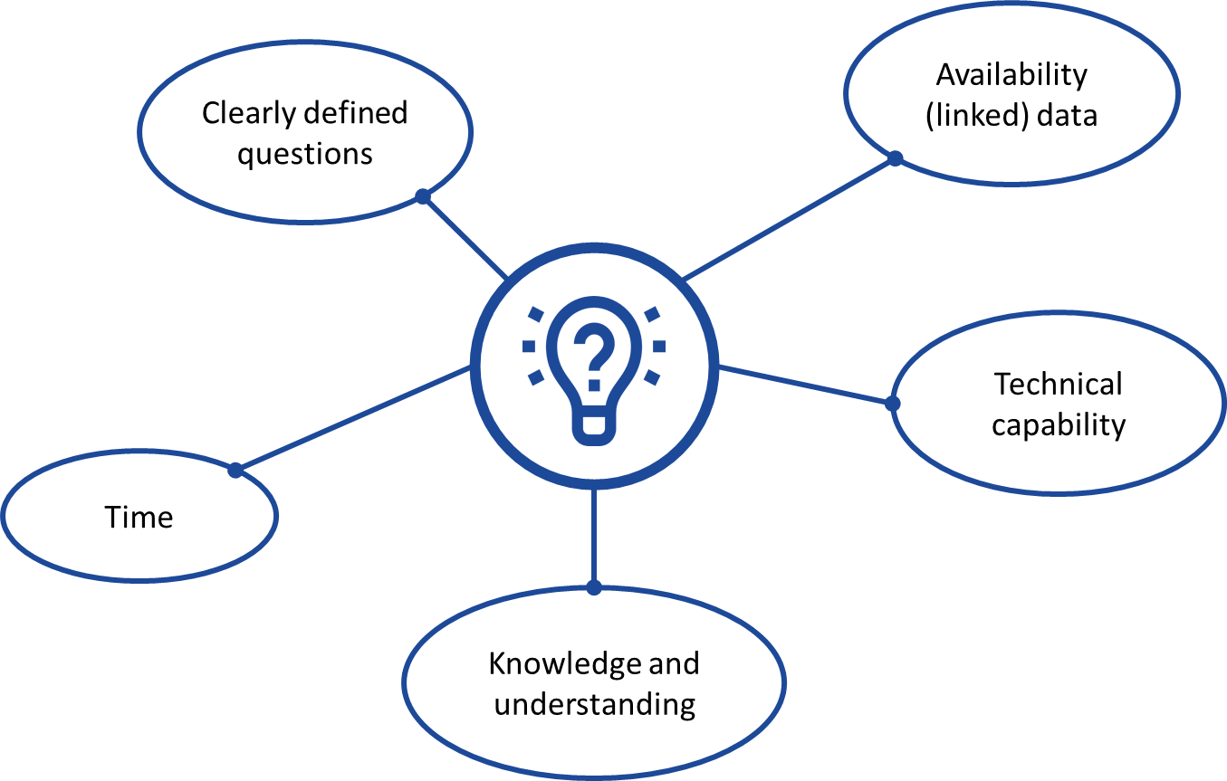
Challenges of embedding PHM in healthcare analytics
Notes:
Change in approach
In our system we now have record level linked data for our entire population, including demographic information, primary and secondary care and community – and I know linked data is a high priority for many systems
Focus on tackling health inequalities and challenges presented by COVID means there is a growing awareness of the value of population level analysis.
Whilst this is a relatively new area of analysis that moves us away from routine reporting there is enthusiasm to learn new techniques and approaches to analysing population level data
One of the values of having an easy to use tool is that it can be easily interrogated to produced graphical summaries to help structure and drive discussions

Slide 7
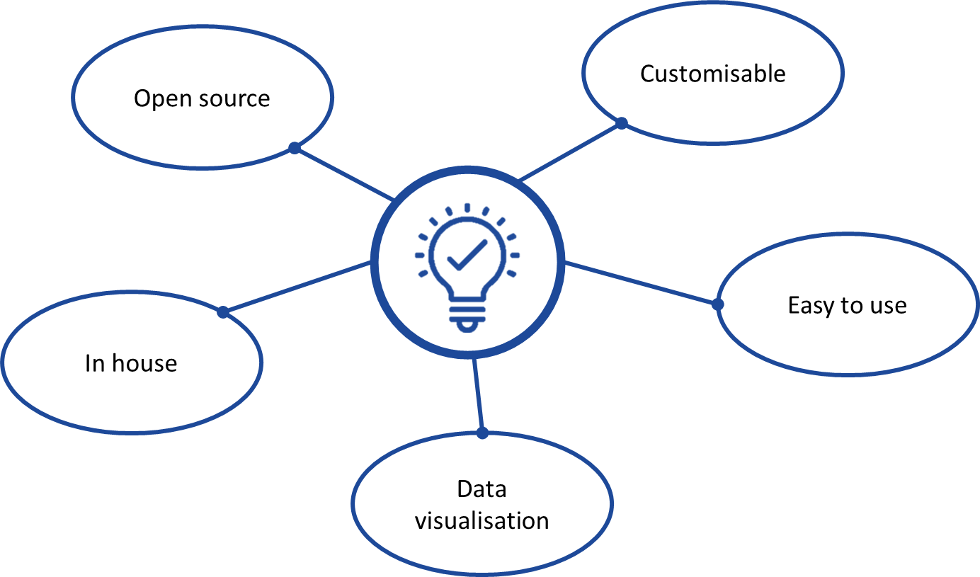
Benefits of using the PHM ExploreR
Notes:
One of the values of having an easy to use tool is that it can be easily interrogated to produced graphical summaries to help structure and drive discussions
Difficulty walking the line between flexibility and user friendliness

Slide 8




PHM ExploreR functionality
Population demographics
Population segmentation
Risk stratification
Patient pathways

Slide 9
Workshop schedule
10:00 - 10:15 Introduction to Population Health Management & the PHM ExploreR
10:15 - 11:00 Data format, demographics, segmentation
11:00 - 11:05 Break
11:05 - 11:45 Risk stratification, Theoplots
11:45 - 12:00 Questions
Notes:
There will be time to ask questions as we go
I’ll be watching the chat to key an eye in question

Slide 10
The PHM ExploreR: Data

Slide 11
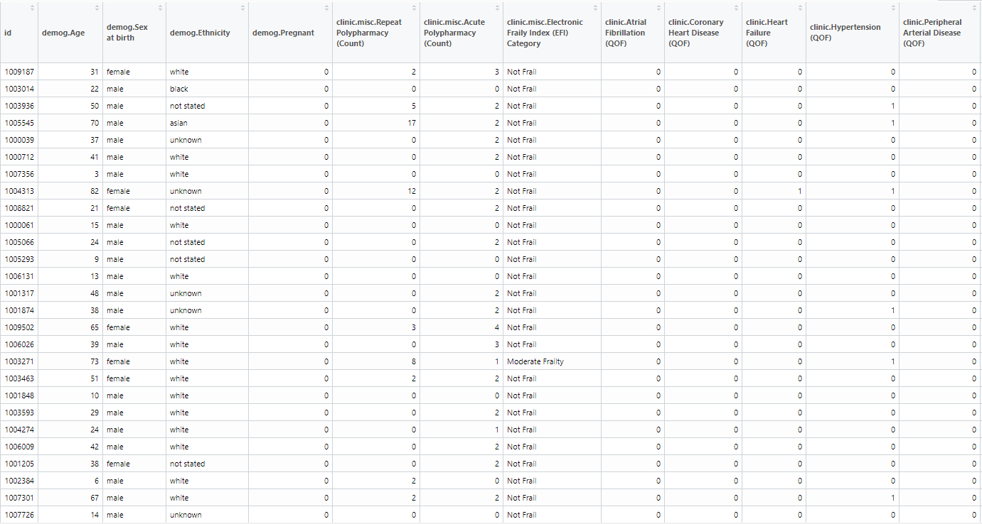
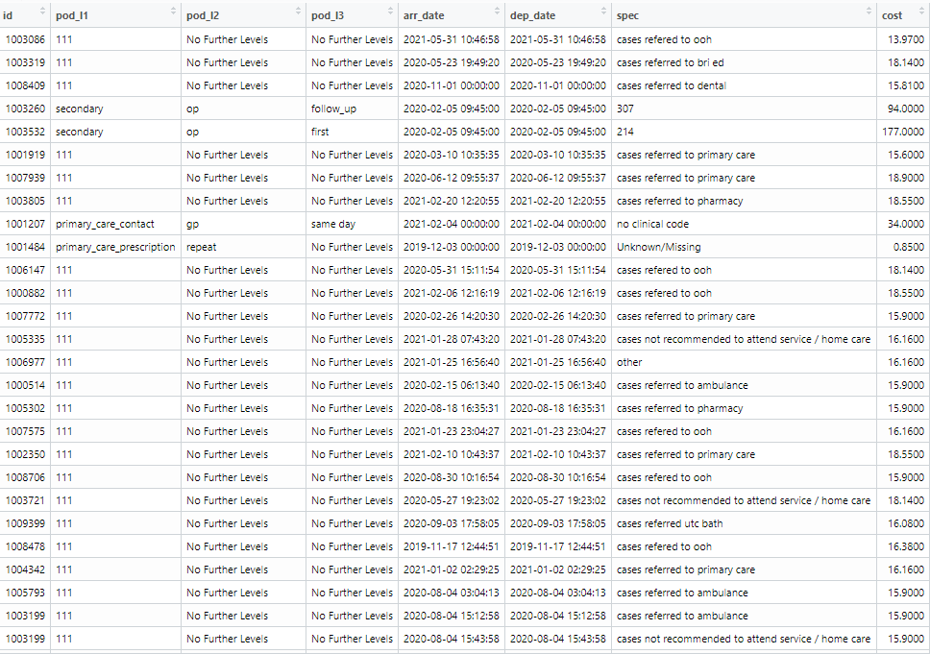
ExploreR data tables
Two separate data files (.csv or .rds format) linked by patient ID
Attributes
Activity

Slide 12
Attributes table
Contains demographic, clinical and socio-economic attributes data
Patient IDs link to activity table
Header prefixes define data type
One patient per row

Slide 13
Minimum data requirements - attributes
Patient ID
Sex
Age
Ethnicity
IMD (or a deprivation grouping)
At least one geographical field (e.g. locality, PCN)
At least one clinical condition

Slide 14
Activity table
Patient IDs link to attribute table
One activity event per row

Slide 15
Minimum data requirements - activity
Point of Delivery (POD)
Categorises activity types (as many as necessary)
Arrival Date
Departure Date
Specialty
Cost

Slide 16
We will now start the interactive part of the workshop!

Slide 17
What use has the ExploreR seen?
BNSSG: Effect of Pregnancy on Covid-19 Vaccine Uptake
East Suffolk and North Essex NHS Foundation Trust: Training and Introduction to PHM

Slide 18


Any questions?
@BNSSGAnalytics

